Slide 1
Unit - I
Introduction: Software Products and Software process, Process models: Waterfall modal, Evolutionary Development, Bohemia’s Spiral model, RAD Model,Agile Model,Overview of risk management, Process visibility,Professional responsibility, Computer based system engineering,Systems and their environment, system procurement,Sytemn engoineering process, system architecture modelling,Human factors, System reliability Engineering.Requirement and specifications: The requirement engineering process,The Software requirement document,Validation of evolution of requirements,Viewpoint-oriented &method based analysis,Sytem contexts,Social 7organization factors,data flow ,semantic, objects, models,requiremnts specification ,functional and non functional requirements.

Slide 2
SOFTWARE ENGINEERING
Software Engineering is a part of computer science in which several kind of method, thoughts and techniques used for getting the high quality software and computer programs.
Minimum cost
On given time
Continuous production

Slide 3

BENEFITS OF LEARNING SOFTWARE ENGINEERING
Learn the basics of programming
Understand the Software Lifecycle
Become a better leader
Get an understanding of emerging tech
Understand ethical and security concerns
Learn how to be more innovative as a business

Slide 4
AIM OF SOFTWARE ENGINEERING
The key features of Software Engineering that it targets to fulfil:
Every time software is being developed, we get quality software at the end as a result.
The Software Produced is maintainable and reliable.
The Software is delivered to the customer (or organization) on time.
The Software is completed within budget.
The Software satisfies all the requirements that it was supposed to fulfil.

Slide 5
NEED OF STUDYING SOFTWARE ENGINEERING
Software engineering is important because specific software is needed in almost every industry, in every business, and for every function.

Slide 6

THE ROLE OF SOFTWARE ENGINEER
Customer
Software Engineering
Programmer
First law of software engineering
Software engineer is willing to learn the problem domain
(problem cannot be solved without understanding it first)

Slide 7
SOFTWARE PRODUCT
The final software that is delivered to the customer is called the software product. It is the outcome of the entire software development process.
It may include
source code,
data,
user guides,
reference manuals,
installation manuals,
specification documentation etc.

Slide 8
SOFTWARE PRODUCT TYPES
Software product
Generic product
Customized product

Slide 9
Generic products: Generic products are stand-alone systems that are developed by a production unit and sold on the open market to any customer who is able to buy them.
Customized Products: Customized products are the systems that are commissioned by a particular customer. Some contractor develops the software for that customer.

Slide 10
Differences between generic and customized software product
Generic
Customized
For general audience
Tough
Imagine the user
requirements.
Developer owns the specification.
For particular client
Easy
Get requirements from the client.
Customer owns the specification.

Slide 11
SOFTWARE PROCESS
The software process is the entire way in which we produce the software. It is the entire journey from the idea of the Software to the final release of it. It includes all the activities that are performed to the form the final Software product, like
the requirement analysis,
designing of the software
coding
testing
deployment
maintenance, etc.

Slide 12
FUNDAMENTAL ACTIVITIES IN SOFTWARE PROCESS
Software Specification
-defining specification of software product.
Software Development
-designing and programming of the software.
Software Validation
-the software is checked to make sure it satisfies the user needs.
Software Evolution
-the software is modified to meet the changing requirement of the user

Slide 13
The software product does not have any information regarding the software process, like how it was scheduled, how many people worked on it, how the work was divided, etc. It only consists of the final application that fulfils the user's requirements.

Slide 14
The software product can also be defined as the collection of all the activities that as a result leads to the formation of the software product. The Software Product may not contain details about the software process, but the software process has every detail about the final product from the very initial phase itself that how the software would be like.

Slide 15
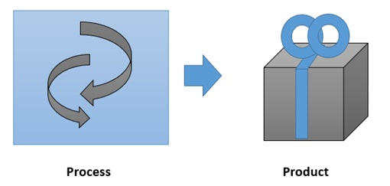
RELATION BETWEEN SOFTWARE PRODUCT AND SOFTWARE PROCESS
Software product is more dependent upon the software process.

Slide 16
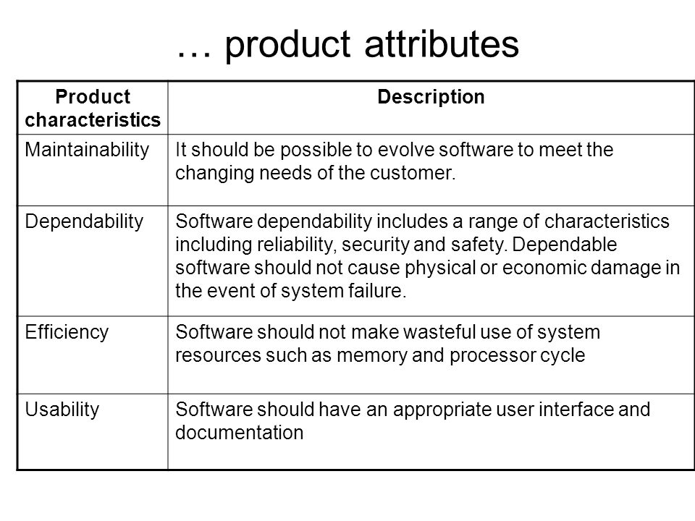

Slide 17
SOFTWARE LIFE CYCLE MODEL AND ITS TYPES
A life cycle model is also known as a process model.
It gives us a pictorial representation of the entire software development process.
The life cycle model deals with each phase of the software development process and includes all the activities that are involved in its life cycle,

Slide 18
PHASES OF SOFTWARE DEVELOPMENT LIFE CYCLE
Planning
Defining
Designing
Building
Testing
Deployment

Slide 19
Stage 1:Planning and requirement analysis
Most important and fundamental stage. Performed by senior members of the team with input from the customer.
Stage2:Defining requirements
Once the requirement analysis is done the next step is to clearly define and document the product requirements and get them approved by the customer. This is done through an SRS(Software requirement specification)
Stage 3:Designing
The product architect will come out with best architecture for the product to be developed based on SRS. Usually more than one design approach for the product architecture is proposed and documented in a DDS(Design Document Specification)

Slide 20
Stage 4:Building / developing
In this stage of SDLC the actual development and the product is built. The programming language is chosen with respect to the type of software being developed.
Stage 5:Testing
This stage refers to the testing only stage of the product where product defects are reported ,tracked, fixed and retested, until the product reaches the quality standards defined in the SRS.
Stage 6:Deployment and maintenance
The product may first be released in the limited segment and tested in the real business environment(UAT-User Acceptance Testing).

Slide 21
TYPES OF SOFTWARE LIFECYCLE MODELS
Waterfall Model
Evolutionary Model
Spiral Model
RAD Model(Rapid Application Development)
Agile Model

Slide 22
THE WATERFALL MODEL
In waterfall model the sequence of steps that are followed in this model resemble the flow of a waterfall.
As the water falls from top to down, in waterfall model you are allowed to move in the direction as that of a waterfall therefore backtracking is not possible in this type of model.

Slide 23
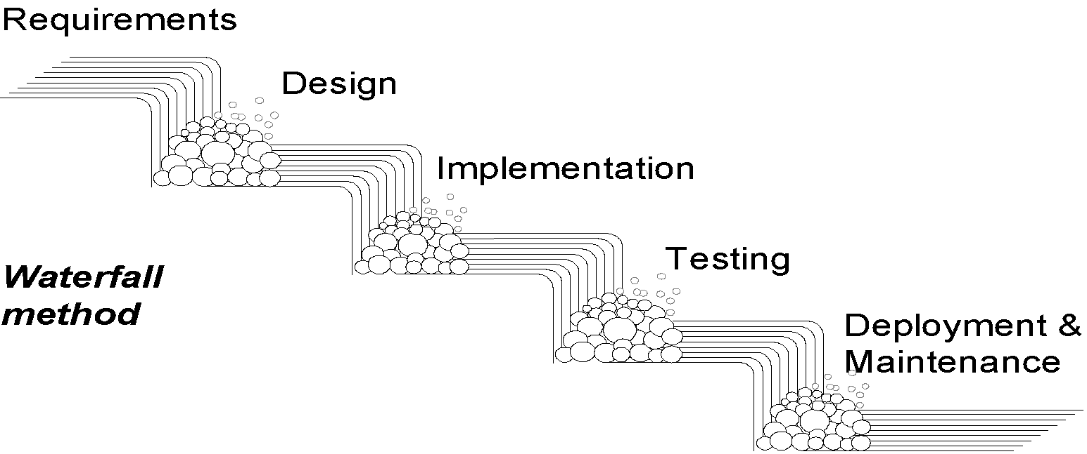
WATERFALL METHOD
Each activity confined to its “phase”.
Unidirectional, no way back; finish this phase before moving to the next

Slide 24
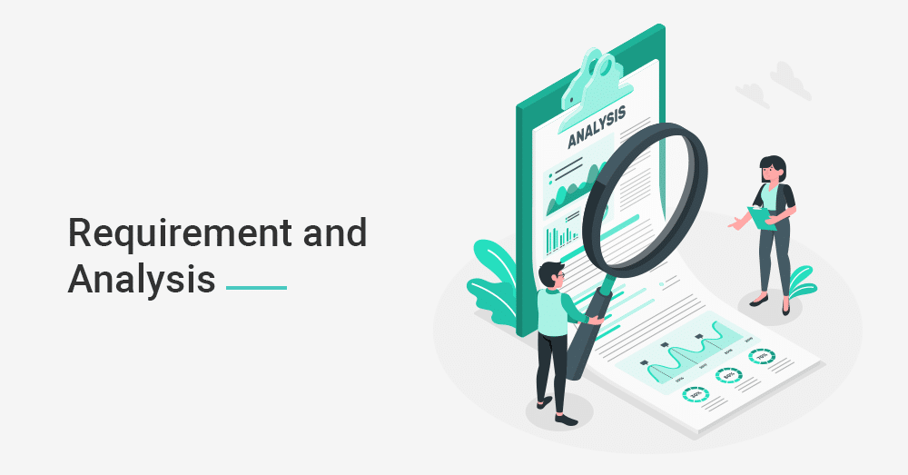

Slide 25
REQUIREMENT AND ANALYSIS
Understanding the exact requirements of the customers and documenting them correctly
Noting all the functions, performance and connecting requirements with the customer and developer.
Brainstorming and studying the requirements by going through a step-by-step analysis
Creating Software requirement Specification (SRS), a detailed document describing what the system will do in the common language
This phase talks about the “what” of the system and now “how.”

Slide 26
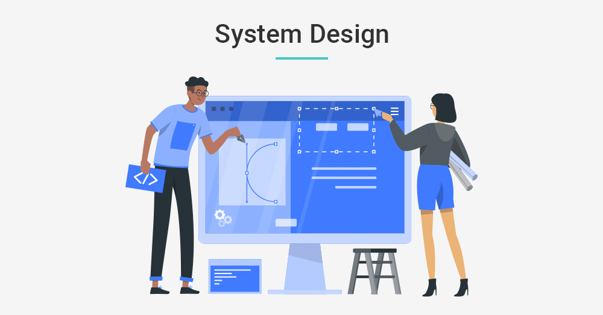

Slide 27
SYSTEM DESIGN
Transforming the requirements collected in the SRS into a suitable form which allows further coding in a programming language.
Describing the overall software structure with detailed design.
Documenting the design, also known as Software Design Document (SDD).

Slide 28
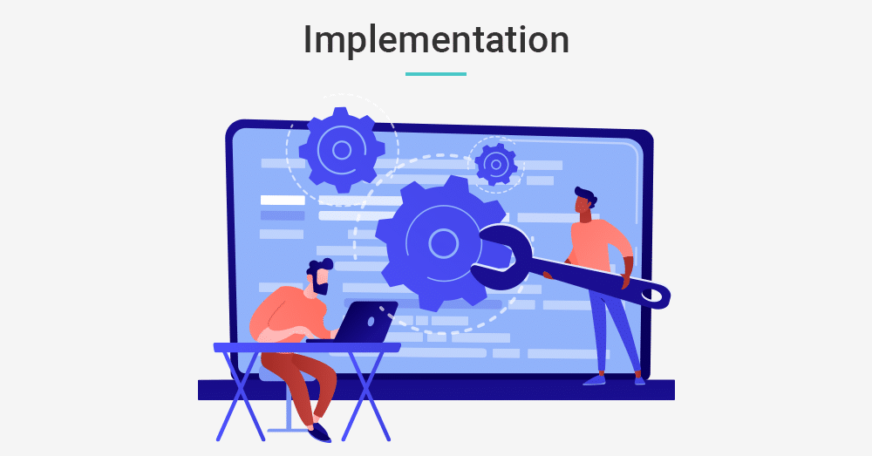

Slide 29
IMPLEMENTATION
Implementing the design as per SDD by developing small programs called ‘units’.
Testing the functionality of the codes through Unit testing.
Integrating the codes in the next phase.

Slide 30
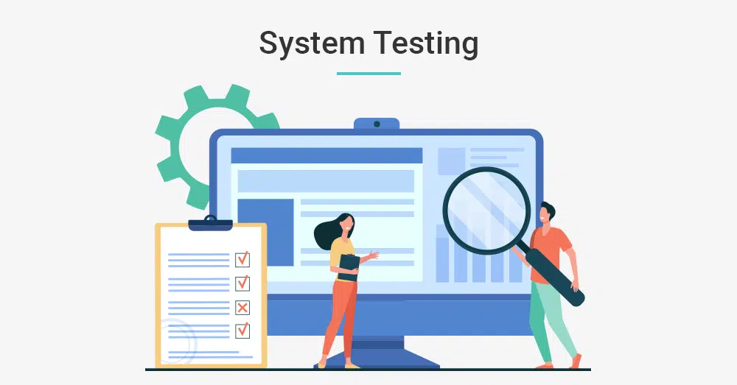

Slide 31
INTEGRATION AND SYSTEM TESTING
Integrating the unit tested codes into a complete system
Functional and Non-functional testing to ensure that the system meets the requirements.
Determining the quality of the end product through comprehensive system testing.
Reporting the issues if found any anomalies.

Slide 32
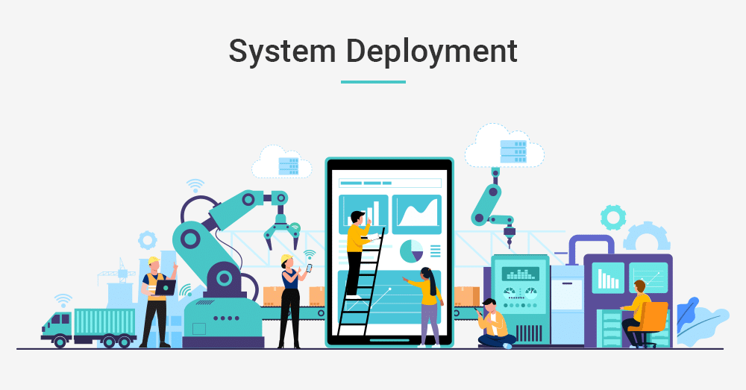

Slide 33
SYSTEM DEPLOYMENT
Deploying the final tested product into the respective customer environment or in the market.
Performing a sanity check in the environment after software deployment to check whether it functions well or not.

Slide 34
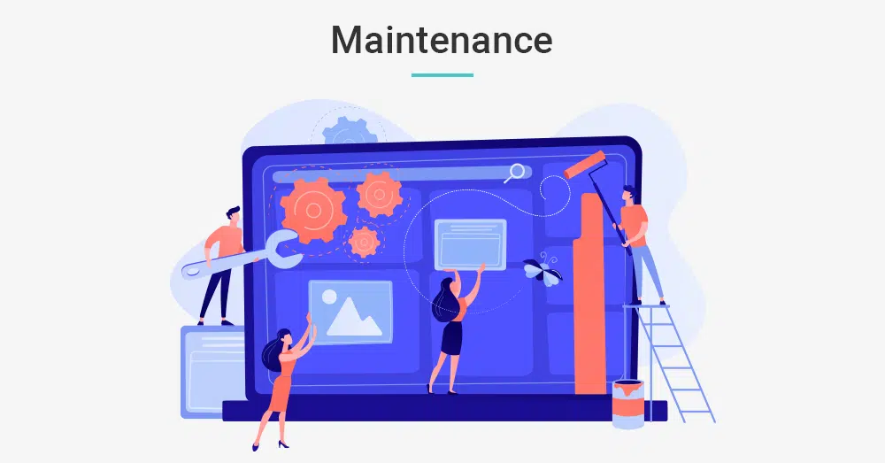

Slide 35
SYSTEM MAINTENANCE
Ensuring that the software is performing well in the respective environment.
Providing maintenance and operational support to the customers after the deployment and installation of the software.
Noting and fixing the issues encountered by the customers, if any.
Updating the system with the latest features.

Slide 36
DISADVANTAGES OF WATERFALL MODEL
It is difficult to define all the requirements at the beginning.
This model is not suitable for introducing any changes in the middle.
Small changes or errors that arise in the completed software may cause a lot of problem.
Clients feedback cannot be included in the ongoing project
Documentation takes a lot of time.
Testing period comes late in the development process.
Not desirable for the complex project

Slide 37
ADVANTAGES OF WATERFALL MODEL
Suited for smaller project
Documentation is done in each phase
Project is completed with minimum client intervention
Any software changes is made during the development phase

Slide 38
WATER FALL MODAL CAN BE USED WHEN:
Requirement are not changing frequently
Application is not complicated and big
Project is short
Requirement is clear

Slide 39
EVOLUTIONARY MODEL
Evolutionary model is also referred to as the successive versions model and sometimes as the incremental model. In Evolutionary model, the software requirement is first broken down into several modules (or functional units) that can be incrementally constructed and delivered

Slide 40
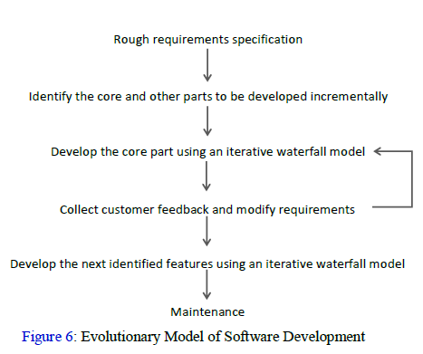

Slide 41
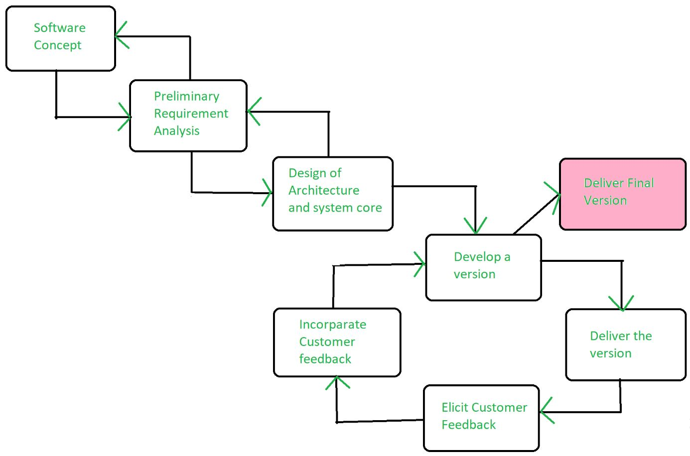

Slide 42
ADVANTAGES OF EVOLUTIONARY MODEL
Large project: Evolutionary model is normally useful for very large products.
User gets a chance to experiment with a partially developed software much before the complete version of the system is released.
Evolutionary model helps to accurately elicit user requirements during the delivery of different versions of the software.
The core modules get tested thoroughly, thereby reducing the chances of errors in the core modules of the final products.
Evolutionary model avoids the need to commit large resources in one go for development of the system.

Slide 43
DISADVANTAGES OF EVOLUTIONARY MODEL
Difficult to divide the problem into several versions that would be acceptable to the customer and which can be incrementally implemented and delivered.

Slide 44
SPIRAL MODEL
The spiral model, initially proposed by Boehm, is an evolutionary software process model that couples the iterative feature.
Using the spiral model, the software is developed in a series of incremental releases.
During the early iterations, the additional release may be a prototype. During later iterations, more and more complete versions of the engineered system are produced.

Slide 45
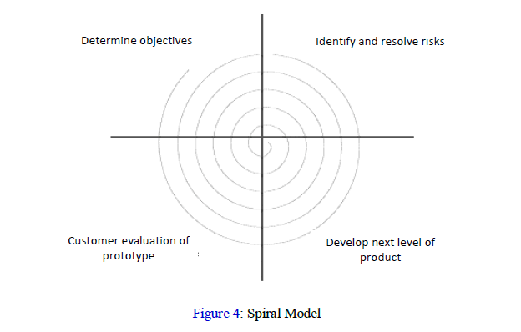

Slide 46
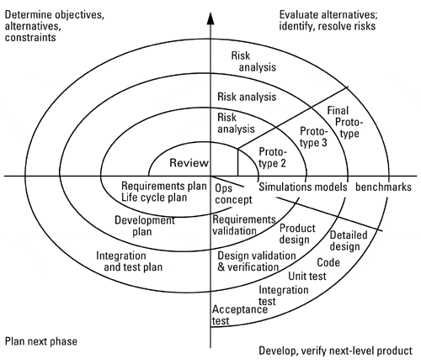

Slide 47
SPIRAL MODEL QUADRANT (PHASES)
First Quadrant (Objective Setting) – Identify the objectives of the phase. – Examine the risks associated with these objectives.
Second Quadrant (Risk Assessment and Reduction) – A detailed analysis is carried out for each identified project risk. – Steps are taken to reduce the risks.
Third Quadrant (Development and Validation) – Develop and validate the next level of the product after resolving the identified risks.
Fourth Quadrant (Review and Planning) – Review the results achieved so far with the customer and plan the next iteration. – Progressively more complete version of the software gets built with each iteration around the spiral.

Slide 48
WHEN TO USE SPIRAL MODEL
When deliverance is required to be frequent.
When the project is large
When requirements are unclear and complex
When changes may require at any time
Large and high budget projects

Slide 49
ADVANTAGES
High amount of risk analysis
Useful for large and critical projects.
DISADVANTAGES
Can be a costly model to use.
Risk analysis needed highly particular expertise
Doesn't work well for smaller projects.

Slide 50
AGILE MODEL
The Agile process model is more focused on delivering working software. Agile can accommodate changes easily and has shown tremendous outcomes in delivering software. That is the reason it has become such a popular name among IT developers and organizations

Slide 51
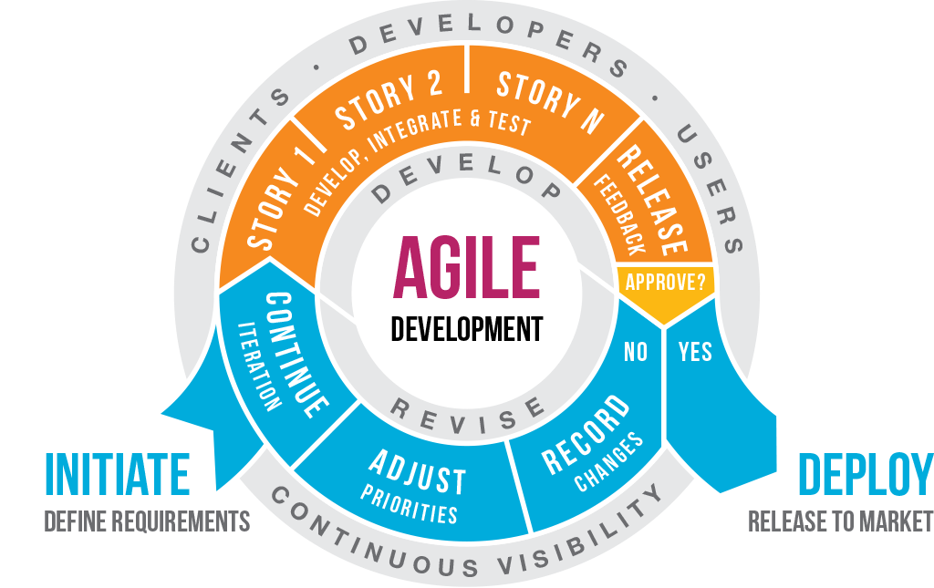

Slide 52
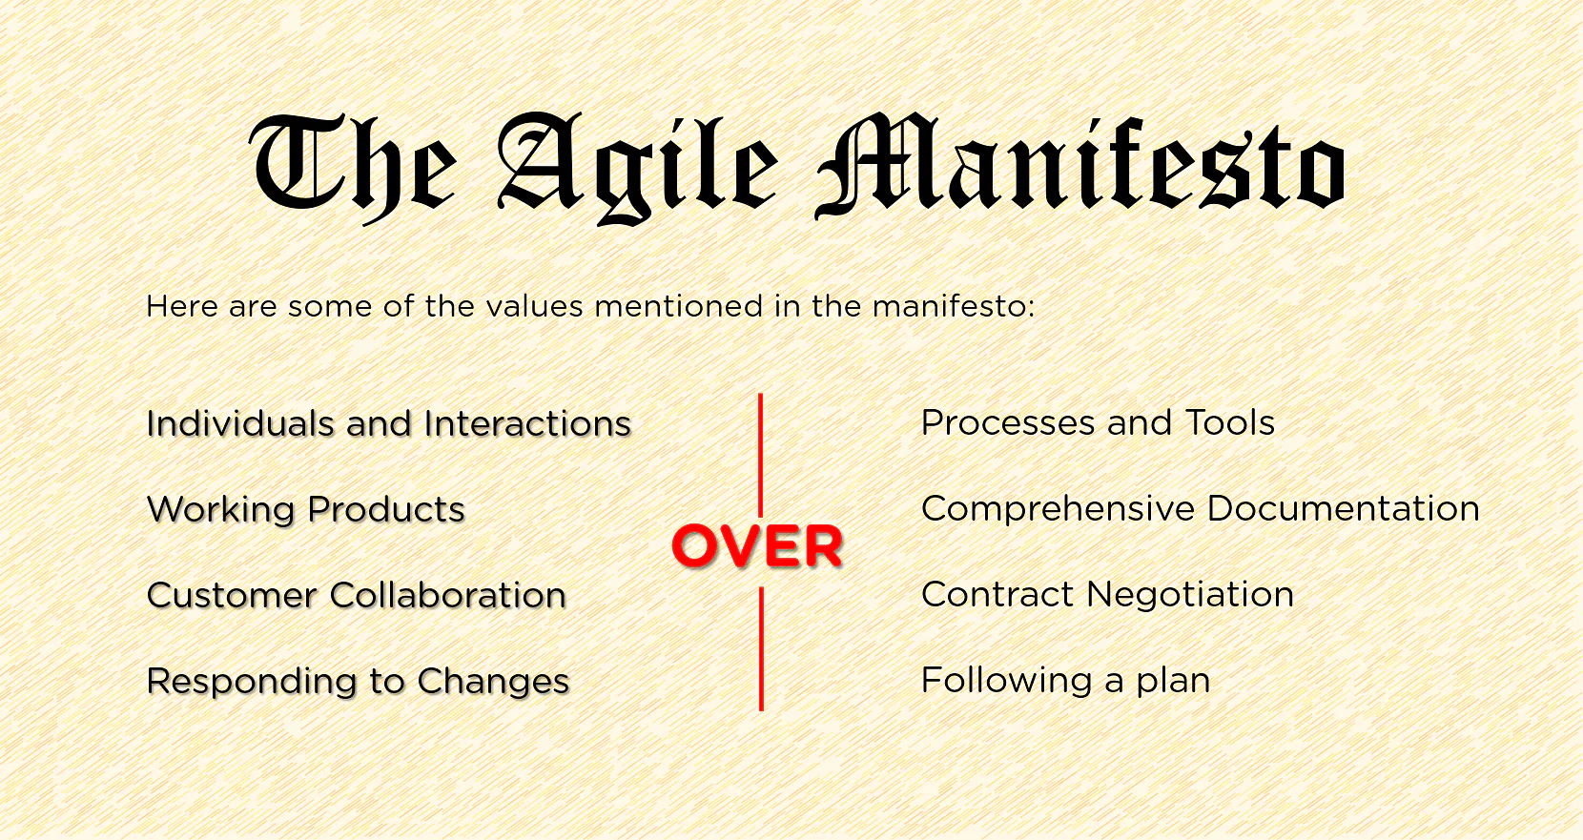

Slide 53
AGILE VALUES
Value 1: Individuals and interactions
In the past, a lot of software teams would concentrate on having the best possible tools or processes with which to build their software. The Agile Manifesto suggests that while those things are important, the people behind the processes are even more so.
Value 2: Working software
Previously, software developers would spend ages creating detailed documentation. That was before they even started writing a single line of code. And while documentation isn’t a bad thing, there comes a point when you should focus on providing your customers with working software.

Slide 54
Value 3: Customer collaboration
Once upon a time, contracts were king. You would draw up contracts with your customers who would then detail the finished product. As a result, there was often a contrast between what the contract said, what the product did, and what the customer actually required.
Value 4: Responding to change
the Agile Manifesto suggests that a software team should have the ability to pivot and change direction whenever they need to, with a flexible roadmap that reflects that. A dynamic roadmap can change from quarter to quarter, sometimes even month to month, and agile teams are able to keep up with those changes.

Slide 55
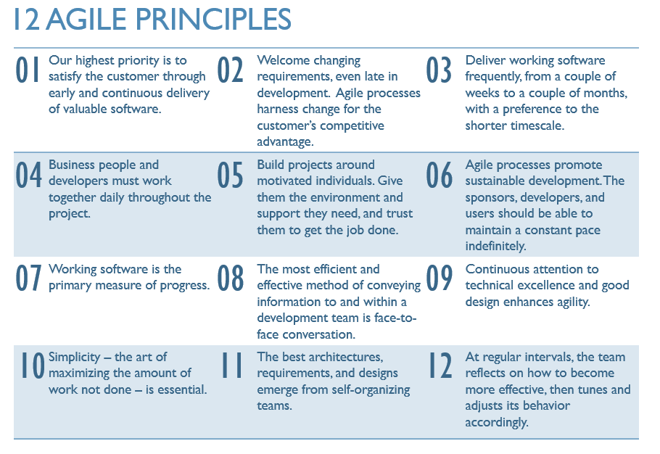

Slide 56
RAD
RAD Model or Rapid Application Development model is a software development process based on prototyping without any specific planning. In RAD model, there is less attention paid to the planning and more priority is given to the development tasks. It targets at developing software in a short span of time.

Slide 57
MODELING HAS FOLLOWING PHASES
Business Modeling
Data Modeling
Process Modeling
Application Generation
Testing and Turnover

Slide 58
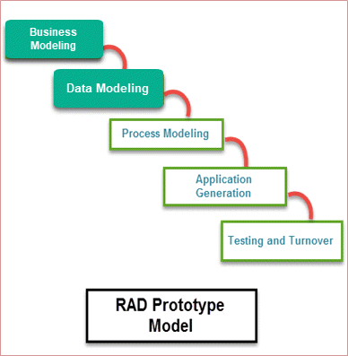

Slide 59
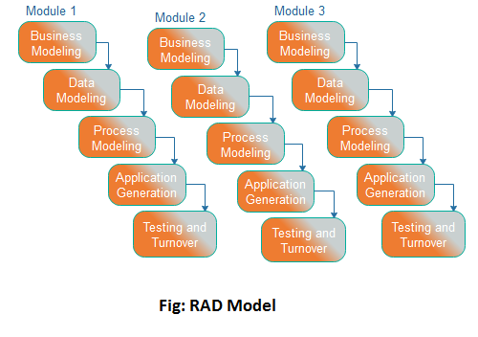

Slide 60
RAD Model Phases | Activities performed in RAD Modeling
Business Modeling | On basis of the flow of information and distribution between various business channels, the product is designed
Data Modeling | The information collected from business modeling is refined into a set of data objects that are significant for the business
Process Modeling | The data object that is declared in the data modeling phase is transformed to achieve the information flow necessary to implement a business function
Application Generation | Actual system is built. Coding is done.
Testing and Turnover | As prototypes are individually tested during every iteration, the overall testing time is reduced in RAD.

Slide 61
WHEN TO USE RAD METHODOLOGY?
When a system needs to be produced in a short span of time (2-3 months)
When the requirements are known
When the user will be involved all through the life cycle
When technical risk is less
When a budget is high enough to afford designers for modeling along with the cost of automated tools for code generation

Slide 62
ADVANTAGES OF RAD MODEL
It is useful when you have to reduce the overall project risk
Flexible and adaptable to changes
It is adaptable and flexible to changes
Due to prototyping in nature, there is a possibility of lesser defects
With less people, productivity can be increased in short time

Slide 63
DISADVANTAGES OF RAD MODEL
It can’t be used for smaller projects
Not all application is compatible with RAD
When technical risk is high, it is not suitable
If developers are not committed to delivering software on time, RAD projects can fail
Requires highly skilled designers or developers

Slide 64
Risk Management
Risk management is a proactive approach for minimizing the un certainity and potential loss

